Slide 1

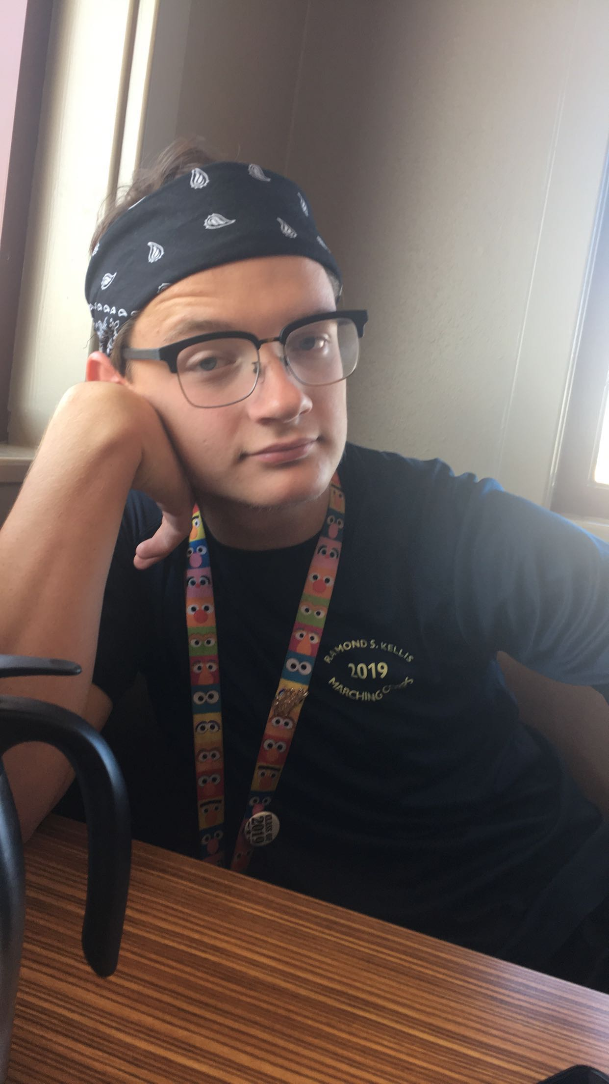
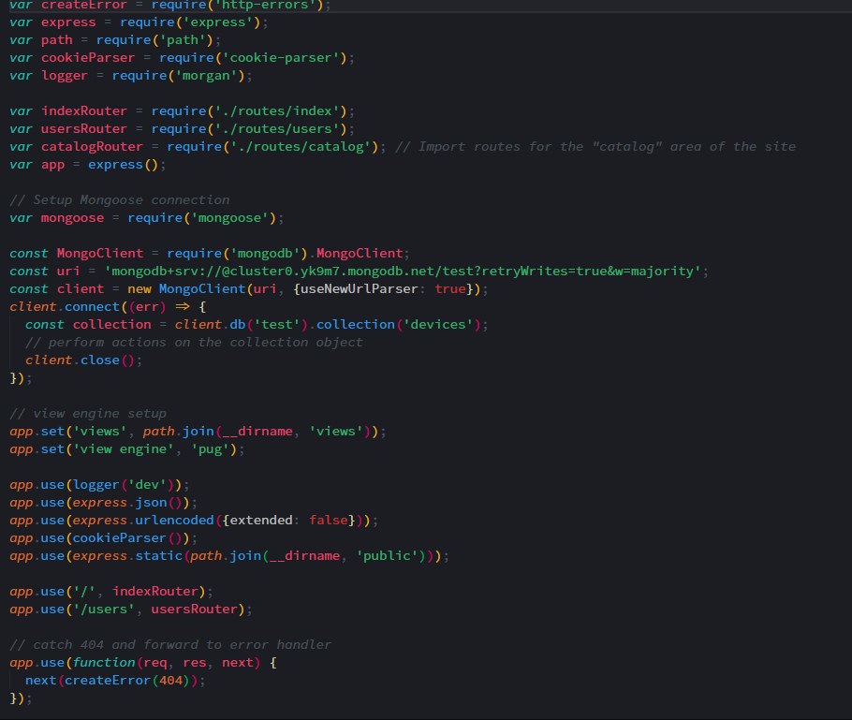
Zackery Hatch
Caring
Selfless
Integrity
Honesty
“If it was meant to be, it would happen. “

